Slide 1

Enter the World of Industry 4.0 with UniStream MQTT

Slide 2


Unitronics adds another piece to the Industry 4.0 puzzle: MQTT
MQTT (Message Queuing Telemetry Transport) is a machine-to-machine connectivity protocol that runs over TCP/IP.
Lightweight, simple, MQTT is based on a publish- subscribe structure:
• A Publisher sends messages according to Topics, to specified Brokers.
• A Broker acts as a switchboard, accepting messages from publishers on
specified topics, and sending them to subscribers to those Topics.
• A Subscriber receives messages from connected Brokers and specified Topics.

Slide 3
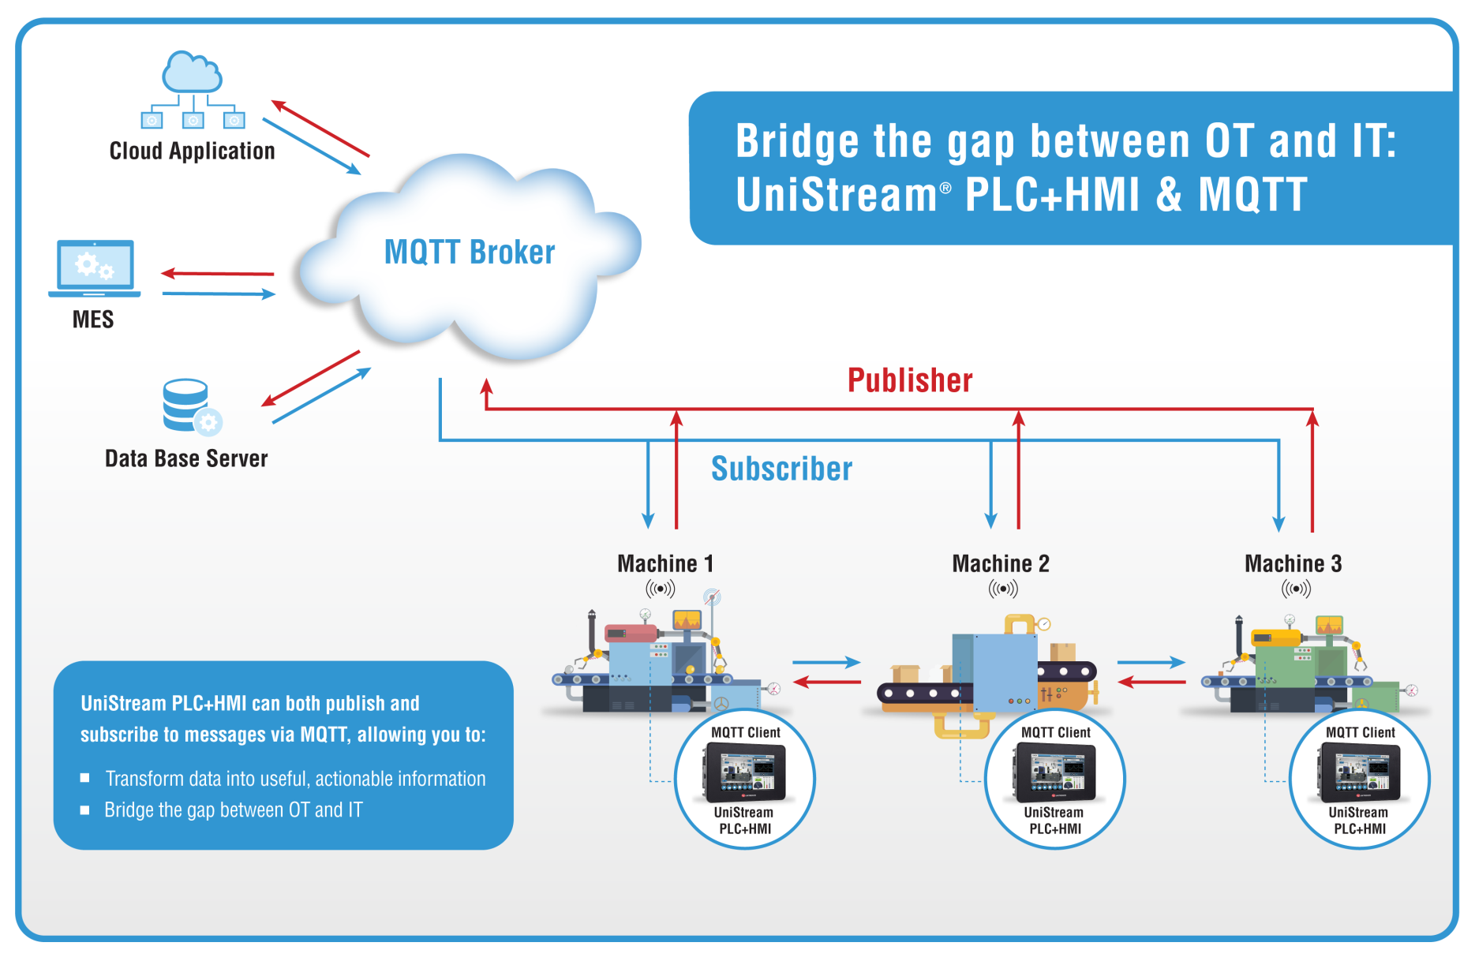
MQTT is based on a publish- subscribe structure

Slide 4
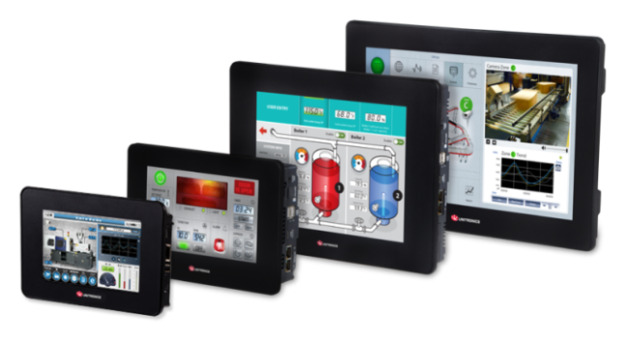
UniStream supports MQTT as a 'client' that can both publish and subscribe to messages
UniStream can:
Publish data to a defined Broker according to a configured Topic. For example, the Topic may be Machine; the messages can include application data such as temperature or pressure. UniStream can publish periodically, according to a time period set in the configuration or a periodically, according to event.
Receive data from a defined Broker on a defined Topic, to which UniStream is subscribed.

Slide 5
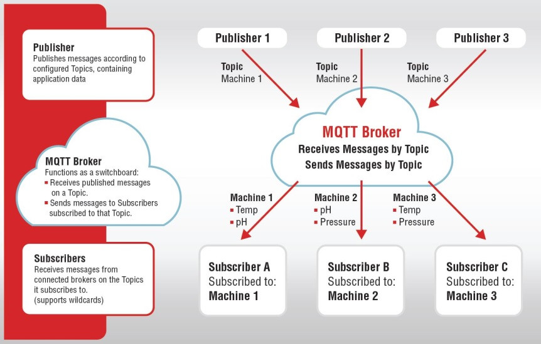
UniStream supports MQTT as a 'client' that can both publish and subscribe to messages

Slide 6

Facing Industry 4.0
In addition to MQTT, UniStream series programmable controllers support a range of communication channels and protocols that supply the connectivity required by Industry 4.0 including SQL, built-in webserver that enables the controller to be accessed via any browser, and more.

Slide 7

Thank you

